Slide 1
NAS Powered Deep Image Prior for EIT
(Slides powered by trying to not look like a slacker next to Kyler.)

Slide 2
Introduction
Neural Architecture Search (NAS)
Deep Image Prior (DIP)
NAS is a technique used to automate neural network designs rather than designing manually.
DIPs are a type of neural network used to enhance an image with no prior training data other than the image itself.

Slide 3
DeepEIT: Deep Image Prior Enabled EIT
Custom Designed
Uses Encoder-
Decoder Network
Takes random noise input and produce a reconstructed conductivity distribution.
Must create different NN architecture to derive optimal priors
Prior: Probability distribution over the parameters of your model. (Priors should reflect our beliefs about the model parameters before observing the data.)

Slide 4
Neural Architecture Search for DeepEIT
Challenge:
Solution:
Efficiently recovering feature maps using the features extract by the encoders
Have the NAS “search space” look at upsampling cells and skip connections
Upsampling: Increasing the resolution or size of a given data set.
Altering spatial resolution
Feature transformation techniques
Kernel size
Dilation rate
Activation functions
Skip Connections: Allow CNNs to bypass certain layers to connect shallow layers to deeper layers
Helps propagate information from earlier layers of the NN to deeper layers

Slide 5
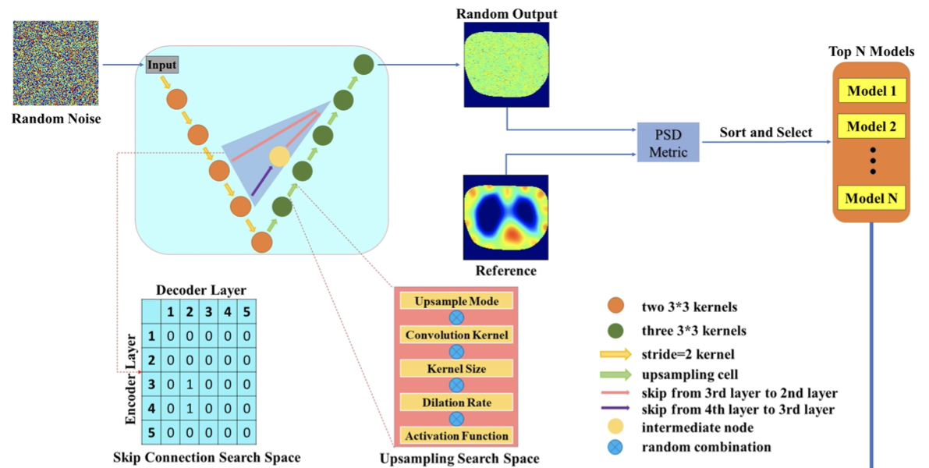
Layout of NAS

Slide 6
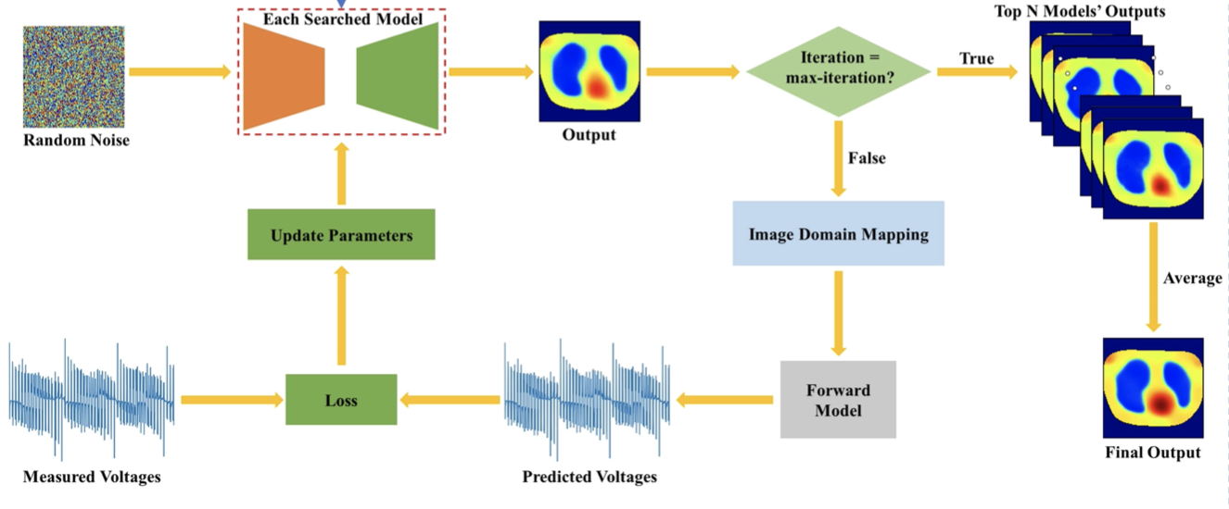
NASDIP Image Reconstruction

Slide 7
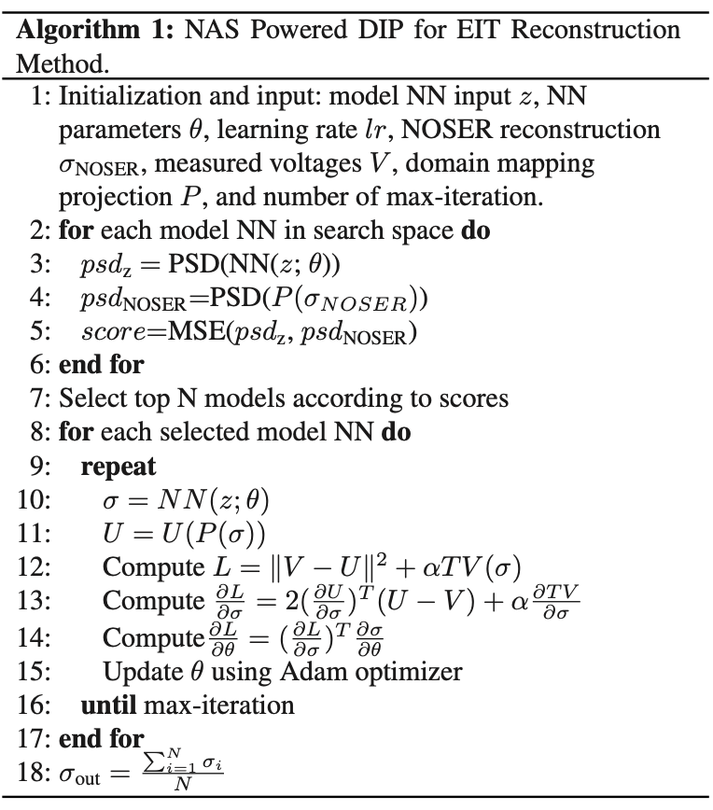
Algorithm for NASDIP
Power Spectral Density (PSD): The similarity in two PSDs of two signals suggests presence of similar structural information between two signals.
If the PSD of a model’s output closely resembles the PSD of the reference conductivity distribution, it indicates the model is suitable for reconstructing the conductivity distribution.

Slide 8
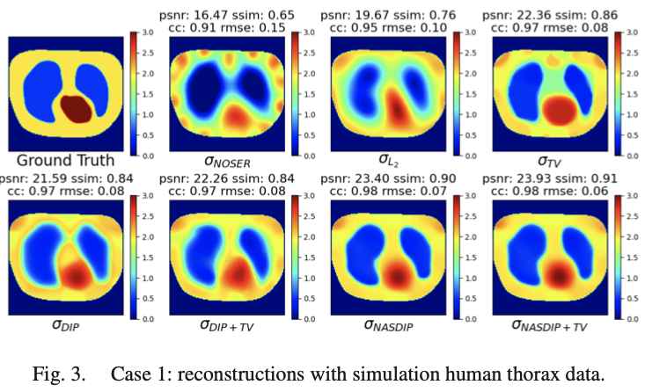
Results

Slide 9
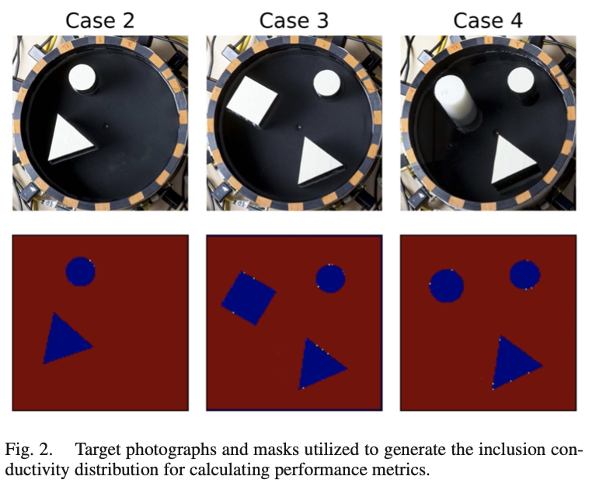
Results

Slide 10
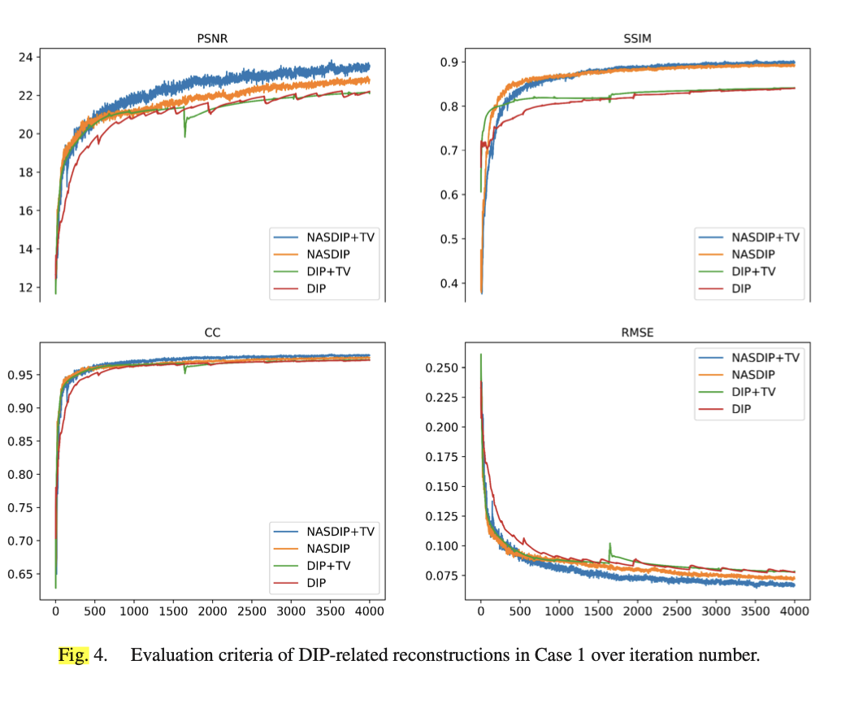
Results

Slide 11
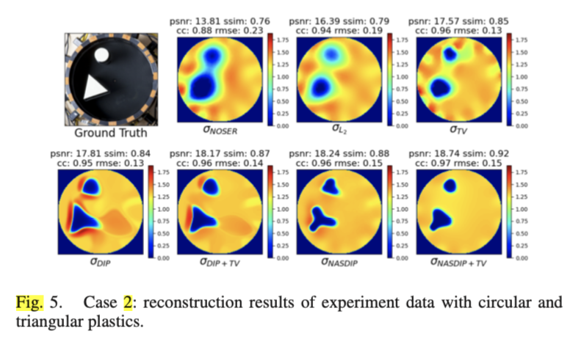
Results

Slide 12
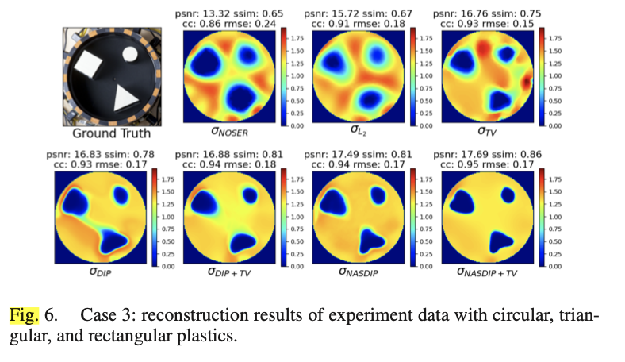
Results

Slide 13
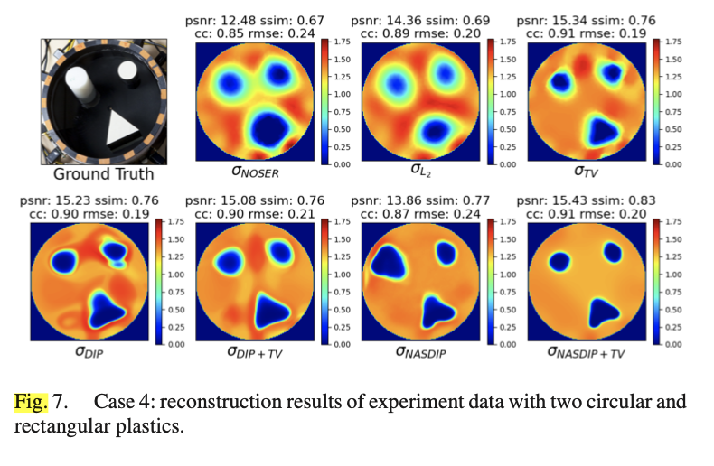
Results

Slide 14
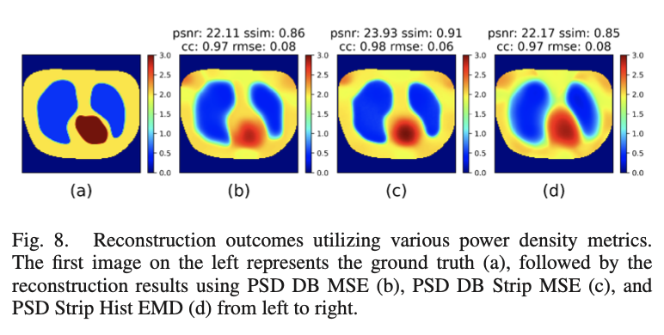
Results

Slide 15
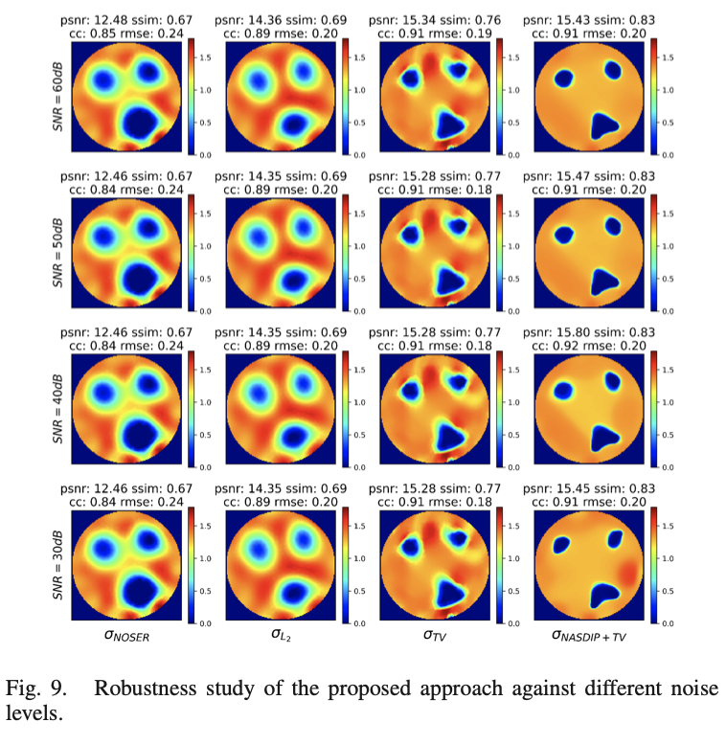
Results

